Slide 1
OLTP Vs OLAP

Slide 2
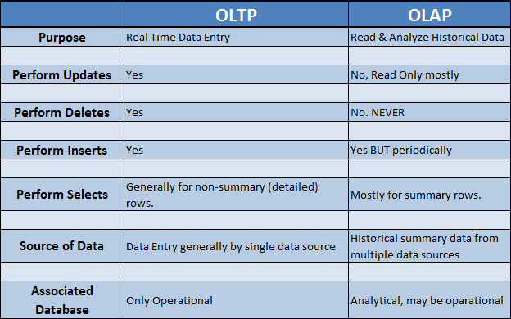

Slide 3
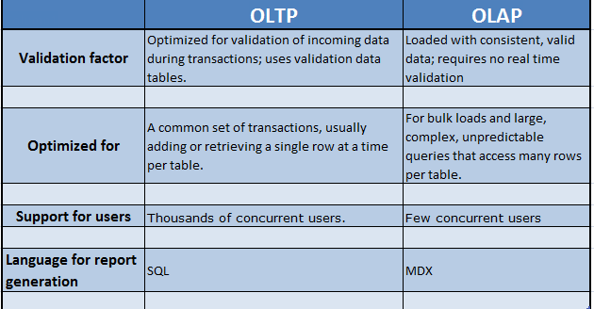
and DAX

